Slide 1

California Housing Prices
Applied Machine Learning with Python

Slide 2

Agenda
Dataset
EDA
Feature Engineering
Model Implementation
Hyperparameter Tuning
Model Evaluation

Slide 3
Dataset
Problem Type
Regression
Target Variable
Median House Value
Source
Kaggle

Slide 4
Dataset
Features:
Longitude
Latitude
Housing median age
Total rooms
Total bedrooms
Population
Households
Median income
Ocean proximity
Shape before cleaning:
20640 x 10
Shape after cleaning:
17994 x 11

Slide 5
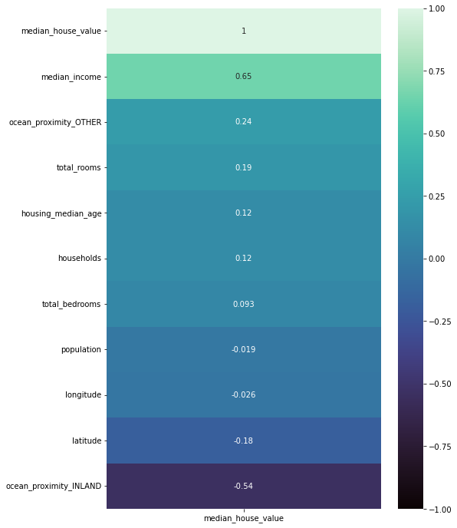
Exploratory data analysis
Correlation:
Median house value and median income are highly positive correlated.
Median house value and ocean proximity inland are negatively correlated.

Slide 6
Exploratory data analysis
Dataset had imbalanced distributions, to fix it we used ‘Lumping’
Before
After

Slide 7
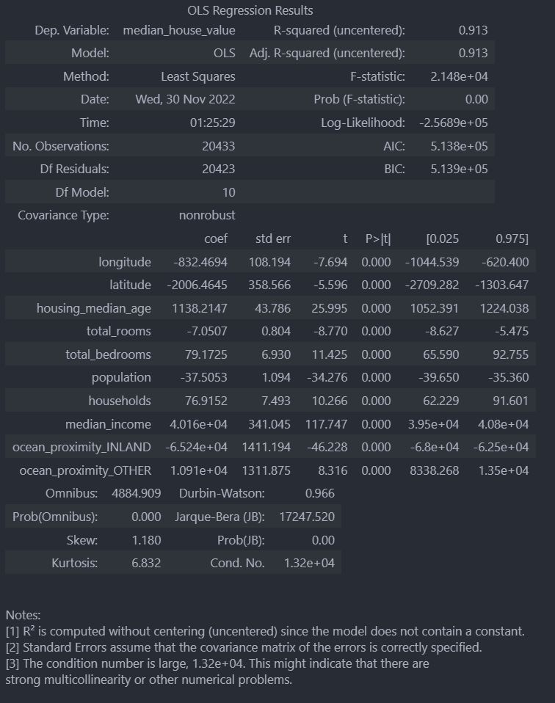
OLS model

Slide 8
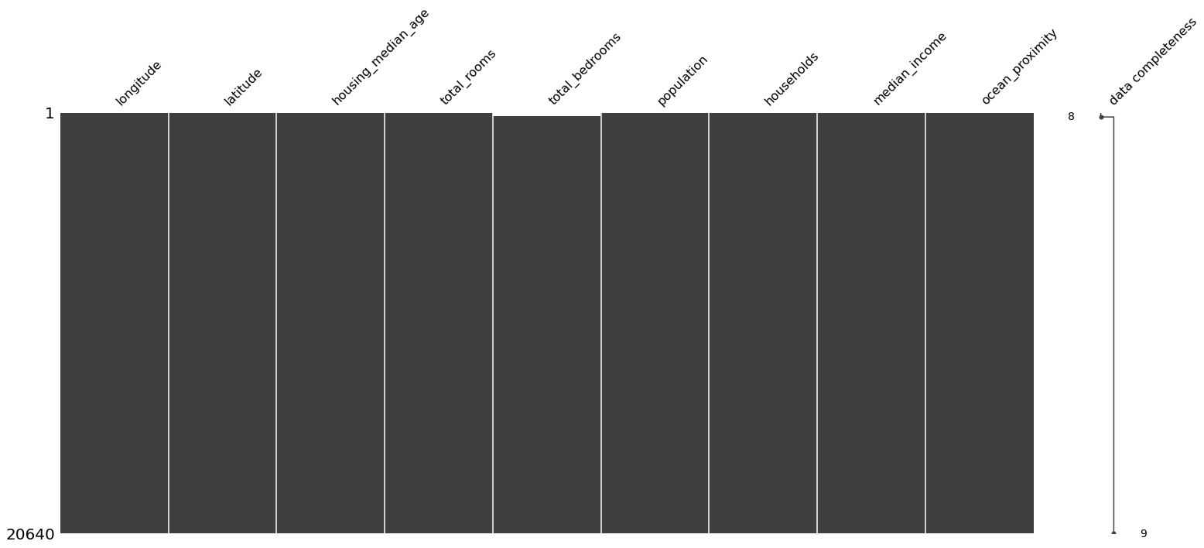
Missingness
Dataset had 207 missing values, after further investigation we found that the values were missing at random

Slide 9
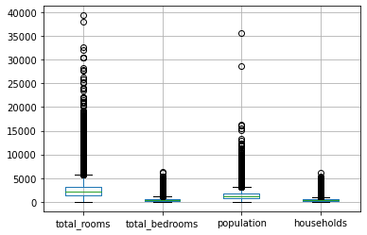
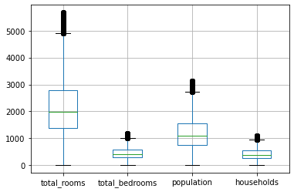
Extreme values
After outlier removal
Before outlier removal

Slide 10
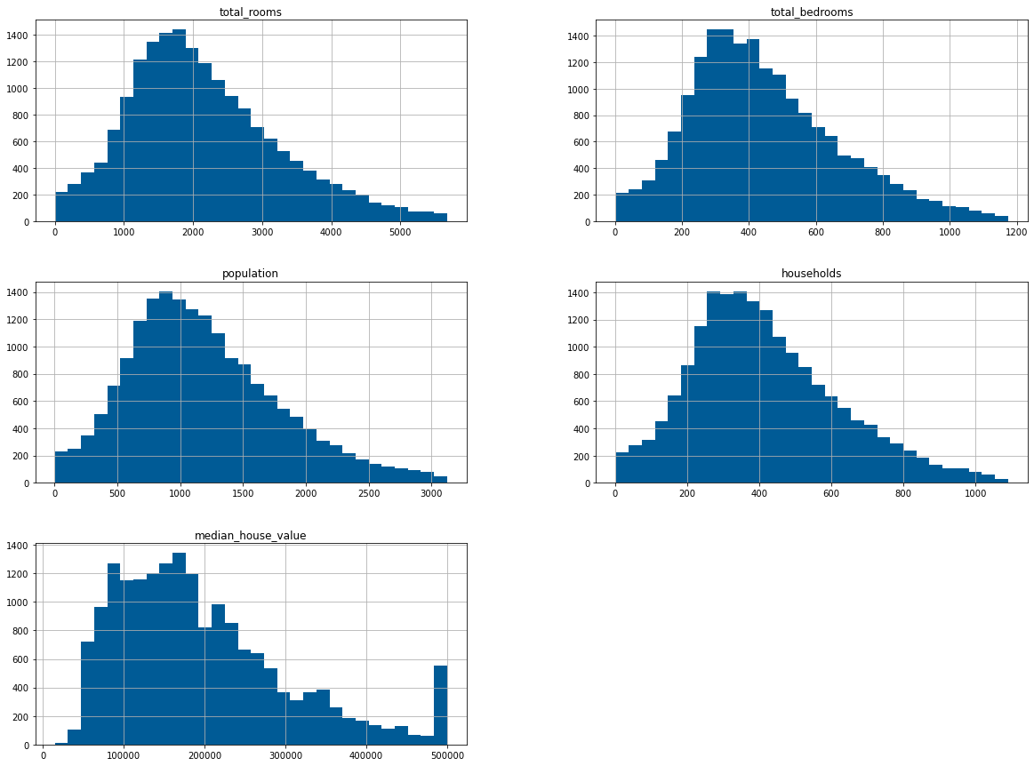
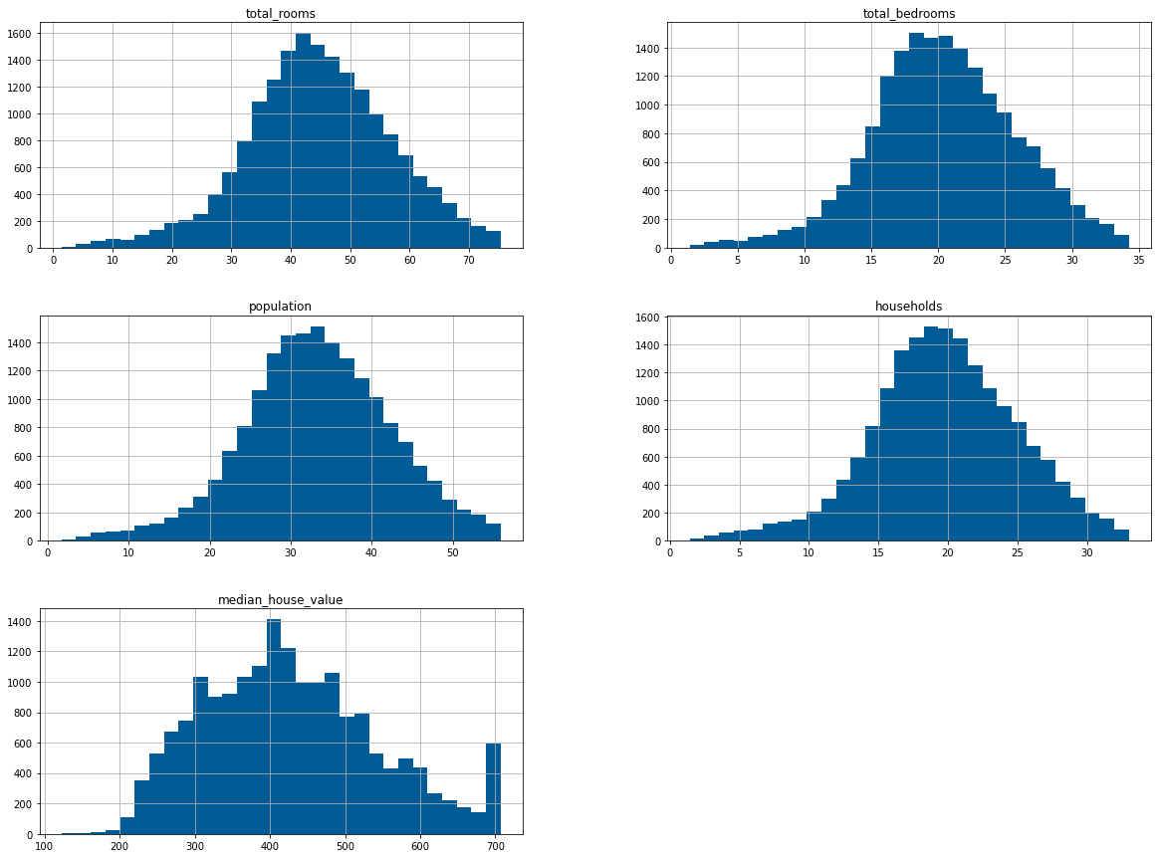
Skewness
While exploring the dataset we found that 5 different features had a right skewed distribution, below are the distributions after performing a square root transformation

Slide 11
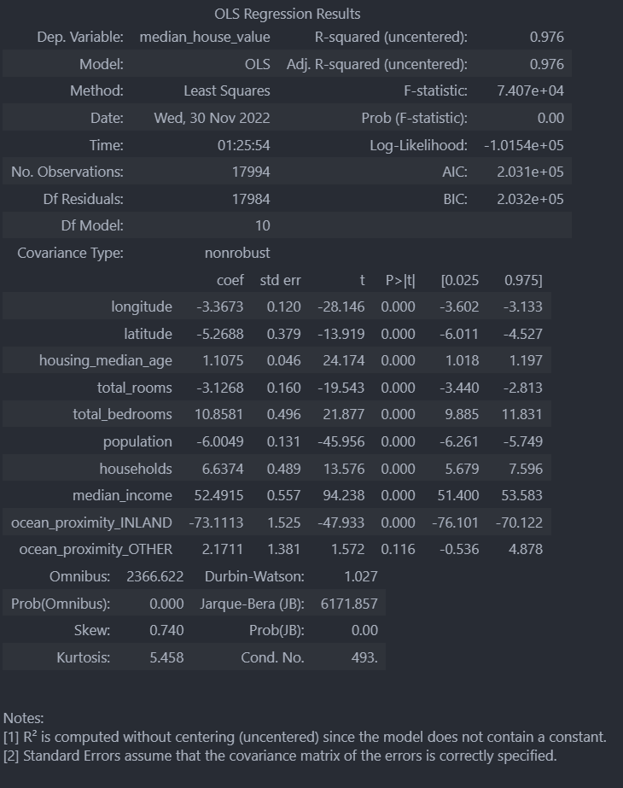
OLS model

Slide 12
Redundant features
Features
Latitude
Housing_median_age
Total_rooms
Median_income
Median_house_value
Ocean_proximity_INLAND
To spot redundant features we used two tests
1. ANOVA

Slide 13
Redundant features
Features
Longitude
Latitude
Housing_median_age
Median_income
Median_house_value
Ocean_proximity_INLAND
To spot redundant features we used two tests
2. Mutual Information

Slide 14
Model Implementation

Slide 15
Data Prep
Splitting the data
70:30
Encoding categorical data
One hot encoding

Slide 16
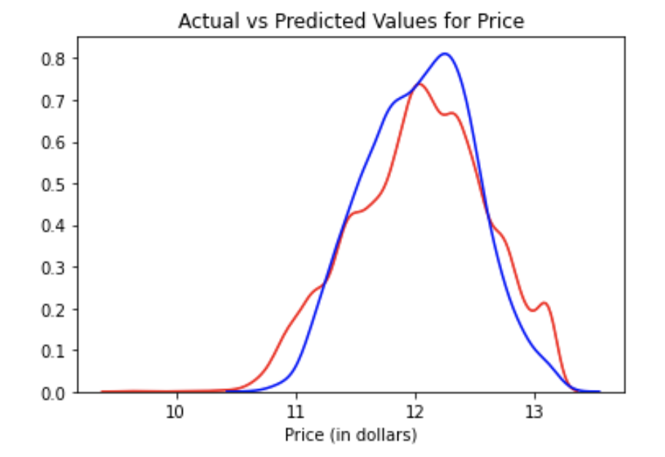
Linear Regression
Trained and fit the model with default parameters
Got RMSE of 0.309

Slide 17
Decision Tree
Trained and fit the model with default hyperparameters
Got RMSE of 0.324
Performed random search and got the following best parameters:
{'min_samples_split': 9, 'min_samples_leaf': 3, 'max_features': 'auto', 'max_depth': 9, 'criterion': 'friedman_mse’}
Used best parameters
Got RMSE of 0.282

Slide 18
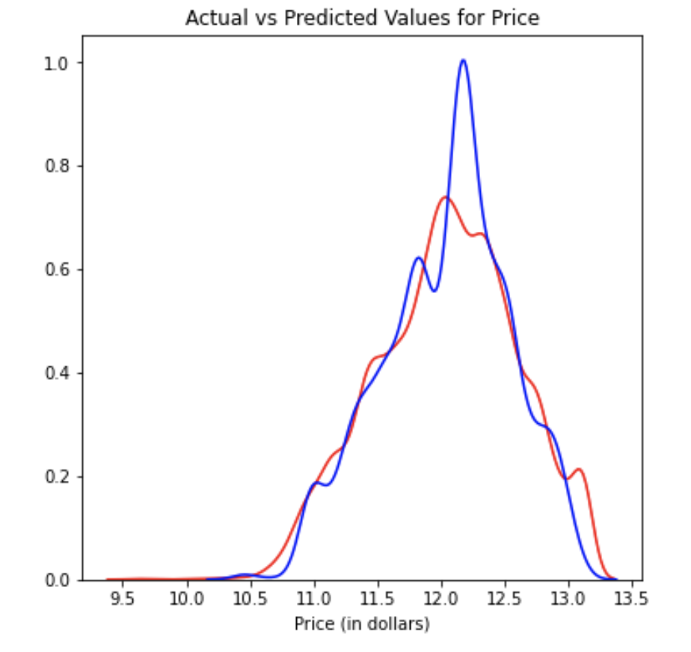
Decision Tree

Slide 19
XGBRegressor
Trained and fit the model with default hyperparameters
Got RMSE of 49.0087
Performed random search and got the following best parameters:
{'n_estimator': 3, 'max_depth': 7, 'eta': 0.1}
Used best parameters
Got RMSE of 325.9228
Performed grid search and got the same parameters

Slide 20
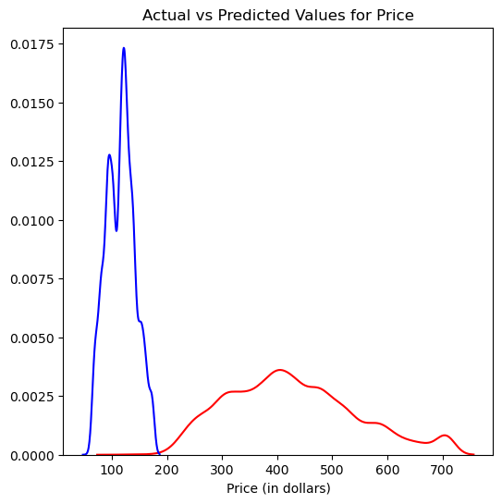
XGBRegressor

Slide 21
Random Forest Regressor
Trained and fit the model with default hyperparameters
Got RMSE of 50.3976
Performed random search and got the following best parameters:
{'n_estimators’: 100, 'min_samples_split': 5, 'min_samples_leaf': 2, 'max_features': ‘sqrt', 'max_depth’: 30, 'bootstrap’: False}
Used random search best parameters
Got RMSE of 66.0274
Performed grid search and got the following parameters
{'bootstrap’: False, 'max_depth’: 30, 'max_features': ‘sqrt', 'min_samples_leaf’: 1, 'min_samples_split’: 2, 'n_estimators': 100}
Used grid search best parameters
Got RMSE of 65.2006

Slide 22
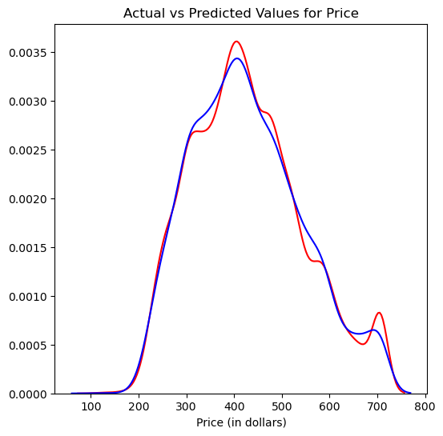
RFR with Grid Search

Slide 23
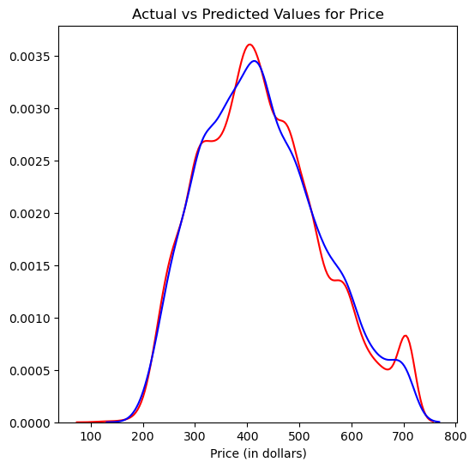
RFR with Random Search

Slide 24
Conclusion after training XGBR and RFR
Random forest regressor performed better than XGBRegressor on this dataset
Trying out different encoding methods could produce better results
Using a different scale could also improve the results

Slide 25
Lasso: Least Absolute Shrinkage and Selection Operator
Data split to train validation test
Lasso regression is a regularization technique used in feature selection using a Shrinkage method also referred to as the penalized regression method.
uses L1 regularization technique , adds absolute value of magnitude of coefficient as penalty
1- cross validation : 10 splits , 3 repeats
2- grid search to find best alpha
3- scaled data and fit it.
Train | Validation | RMSE
0.674 | 0.688 | 65.13

Slide 26
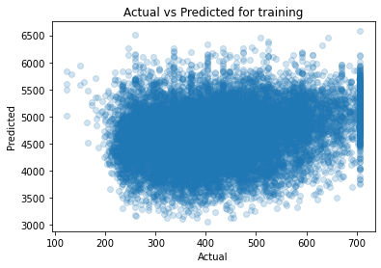
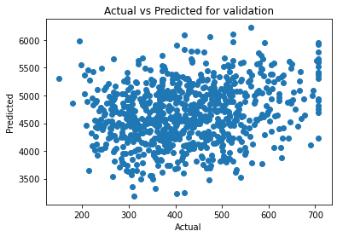
Actual vs Predicted

Slide 27
Ridge
Like the lasso regression, ridge regression puts a similar constraint on the coefficients by introducing a penalty factor.
Ridge Regression is L2 regularization technique , adds squared magnitude of coefficient as penalty term
1- cross validation : 10 splits , 3 repeats
2- grid search to find best alpha
3- scaled data and fit it.
Train | Validation | RMSE
0.674 | 0.688 | 65.13

Slide 28
Polynomial
is a form of regression analysis in which the relationship between the independent variable x and the dependent variable y is modelled as an nth degree polynomial in x
Polynomial features are those features created by raising existing features to an exponent.
polynomial features are a type of feature engineering, e.g. the creation of new input features based on the existing features.
Polynomial with 3rd degree
Train | Validation | test | RMSE
0.770 | 0.762 | 0.723 | 61.28

Slide 29
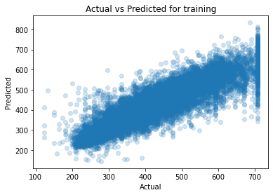
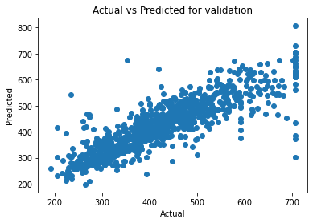
Actual vs Predicted

Slide 30
Conclusion
regularization models all have the same accuracy
Polynomial regression performed butter and its the one we choose to test
it seems there is overfitting in Polynomial regression accuracy
for more feature work we want to improve our accuracy:
adding more data.
feature engineering.
try other models.

